Slide 1
MINI PROJECT 1
WEEK 1
Evaluate the ONLINE sales performance of the company
NhiLT4

Slide 2
TABLE OF CONTENTS:
Define the business needs
Design the dimensional model schema
Find the data sources based on data dictionary documentation
Design SSIS package to ETL the data
Write SQL Queries on the resulted database to answer the business question

Slide 3
DEFINE THE BUSINESS NEEDS
Scenario: A sales analyst is trying to evaluate the ONLINE sales performance of the company.
She will need to produce time-series data based on order date, due date, and ship date to determine the performance of
shipper (based on if the order is on time)

Slide 4
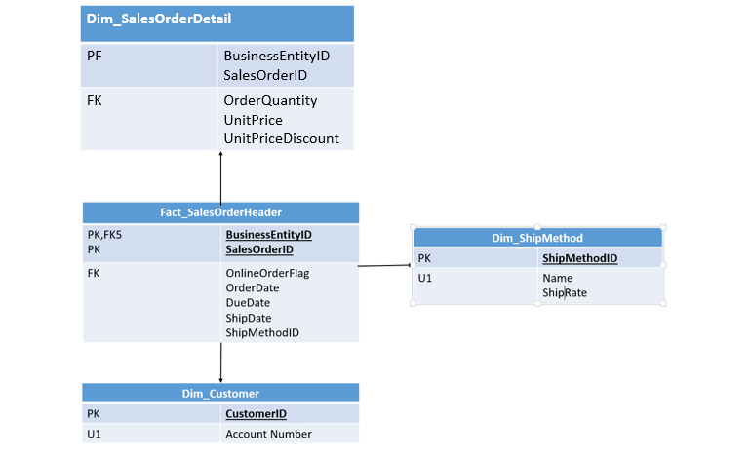
2. Design the dimensional model schema and explain the relationship

Slide 5
3. Find the data sources based on data dictionary documentation
AdventureWorks Database

Slide 6
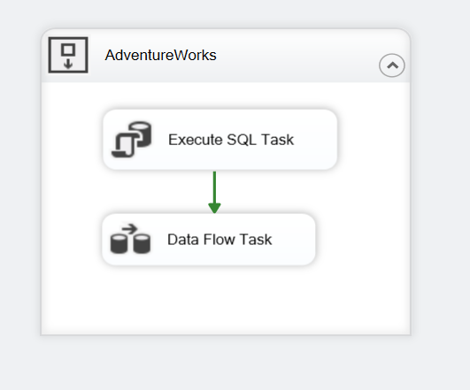
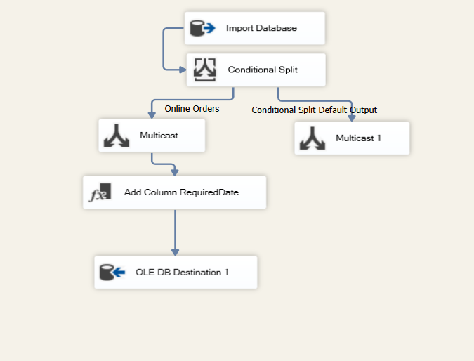
4. Design SSIS package to ETL the data
CONTROL FLOW
DATA FLOW

Slide 7
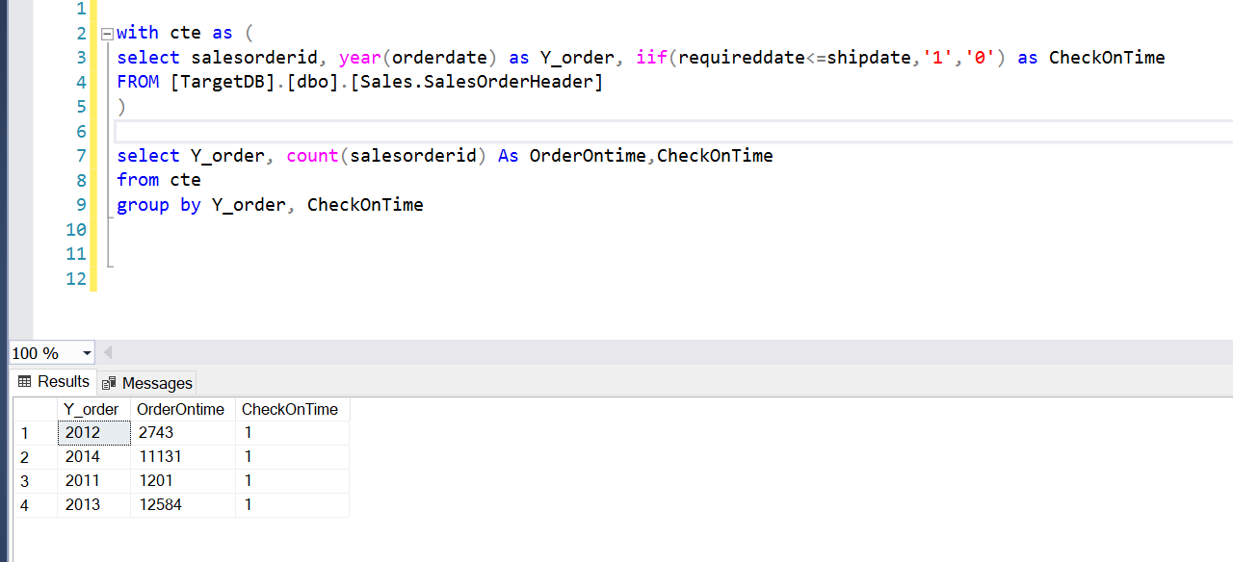
5. Write SQL Queries on the resulted database to answer the business question

Slide 8
THANKS FOR YOUR LISTENING

